Slide 1
Mid-term Paper
Expectations:
MGT301
Management Principles

Slide 2
Mid-term paper expectations
1) The PURPOSE of this paper is for you to demonstrate how management is heavily influenced and heavily influences other disciplinary fields.
2) The REQUIREMENTS of this paper are 2,000 words or more, not including title page, abstract, and references. Use of at least three academic articles (peer reviewed) from an academic database. Business press or new media references are not considered peer-reviewed, academic articles and should not be included.
3) The FORMAT of this paper is in APA. If you have never used APA before I have posted resources in blackboard, and you can always solicit help from the writing center.
4) The EXPECTATIONS are that you include an introduction with thesis statement, supporting body with academic references, and a conclusion.

Slide 3
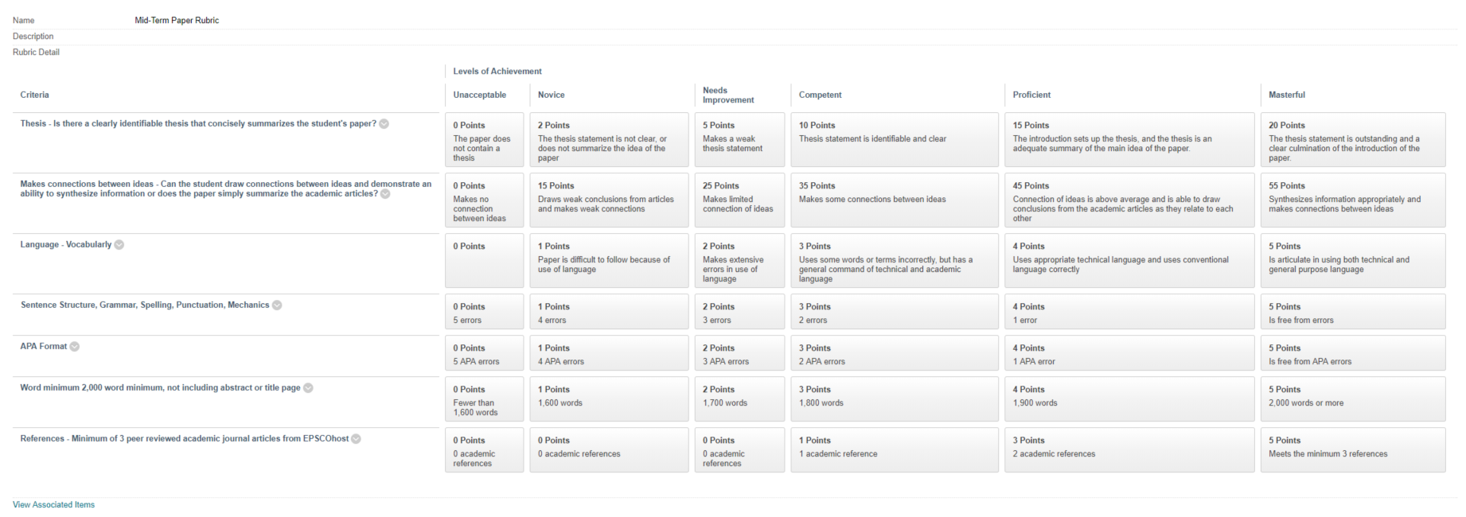

Slide 4
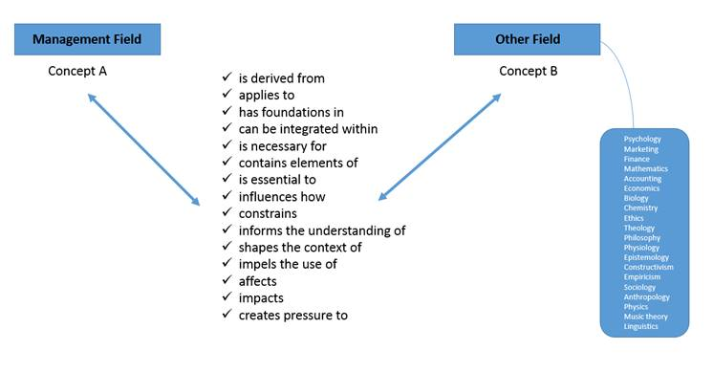

Slide 5
“The use of ABC accounting practice as essential to serving the needs of internal and external stakeholders”
“A review of hotel leakage as a violation of utilitarian ethics”
“False advertising as a form of commutative justice practice”
“Cognitive dissonance associated with shareholder theory practice”
“The importance of emotional intelligence for middle managers”
“Control process applied to marketing strategy”
“Too many control mechanisms: The impact on employee trust, commitment, and motivation”
“Focus groups as a form of management control”
“The use of competitor benchmarking in financial markets”
“Social entrepreneurship as an extension of social psychology”
The code word is: planning

